Slide 1

Chapter 4
modern symmetric-KEY Cipher:
DATA ENCRYPTION STANDARD (DES)

Slide 2
Outlines
Types of modern symmetric ciphers
Feistel cipher
Data Encryption Standard (DES)
Variants of DES

Slide 3
Learning Objectives
In the end of this Chapter 4, students will be able:
To understand the operations and differences between the two major symmetric ciphers of block cipher and stream cipher.
To understand the structure of the Feistel cipher.
To learn and perform the computations surrounding the Data Encryption Standard (DES).
To learn and understand some variants of DES.

Slide 4
STREAM CIPHERS & BLOCK CIPHERS

Slide 5
Types of Symmetric Cipher - Overview
Symmetric ciphers can generally be sub-divided into two major types:
Stream Cipher
The data that is operated (encrypted) as a stream with one bit or one byte at a time.
Examples: Vigenère cipher and Vernam cipher.
Block Cipher
The data is split into smaller blocks of fixed size, and the operation is performed block-by-block to produce ciphertext block of equal size (length).
Example: Keyed Transposition cipher.

Slide 6
Stream Ciphers
The data that is operated (encrypted) as a stream with one bit or one byte at a time.
The plaintext bits are encrypted with a pseudorandom bit-stream (keystream), typically by an XOR (exclusive-OR) operation.
Examples of modern stream ciphers:
Rivest Cipher 4 (RC4)
Software Optimized Encryption Algorithm (SEAL)
Very Efficient Substitution Transposition (VEST)

Slide 7
Stream Ciphers
Advantage:
It executes at a higher speed than block cipher and have low hardware complexity.
If the cryptographic keystream is random, then this cipher is unbreakable by any means other than acquiring the keystream.
Disadvantage:
The distribution of the random keystream is difficult in a larger data traffic (key distribution problem).
Solution: Instead of distributing the long keystream, a bit (keystream) generator is distributed, so that users can generate the keystream whenever necessary.

Slide 8
Stream Ciphers

Slide 9
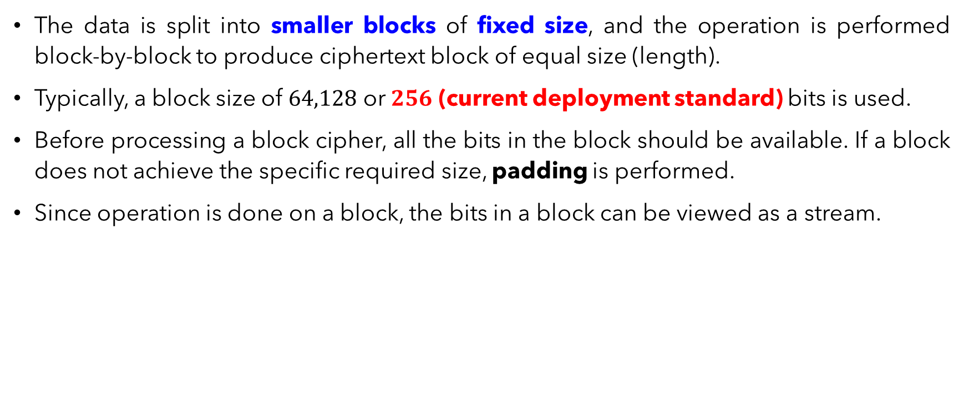
Block Ciphers
The data is split into smaller blocks of fixed size, and the operation is performed block-by-block to produce ciphertext block of equal size (length).
Typically, a block size of $64,128$ or $256$ (current deployment standard) bits is used.
Before processing a block cipher, all the bits in the block should be available. If a block does not achieve the specific required size, padding is performed.
Since operation is done on a block, the bits in a block can be viewed as a stream.

Slide 10
Block Ciphers
Examples of block ciphers:
Data Encryption Standard (DES)
Double DES,
Triple DES,
Advanced Encryption Standard (AES),
Rivest Cipher 5 (RC5),
Blowfish
Note: We will learn some modes of operation in Chapter 6 later and observe that block cipher can be used to achieve the same effect as stream cipher.

Slide 11
FEISTEL CIPHER STRUCTURES (MOTIVATION)

Slide 12

1st Motivation – Block Cipher
A block cipher operates on a plaintext block of $n$ bits to produce a ciphertext block of $n$ bits. Hence there are $2^{n}$ possible different plaintext blocks involved and $2^{n}$ possible ciphertext blocks produced.
For encryption and decryption to be reversible, the map must be unique (one-to-one correspondence).
The map is not unique, as two plaintexts have the same ciphertext.

Slide 13
2nd Motivation – Product Cipher
In the end of Chapter 3, we learn that product cipher combined several technique such as substitution and permutation.
The concept of product cipher was introduced by Claude Shannon in 1949.
Idea: To enable the block ciphers to achieve two important properties:
Diffusion: To hide the relationships between the plaintext and ciphertext. This is done through permutation.
Confusion: To hide the relationships between the key and ciphertext. This is achieved through substitution.
In next slide, an example of how ‘confusion’ is achieved in substitution, and it is called IDEAL block cipher.

Slide 15
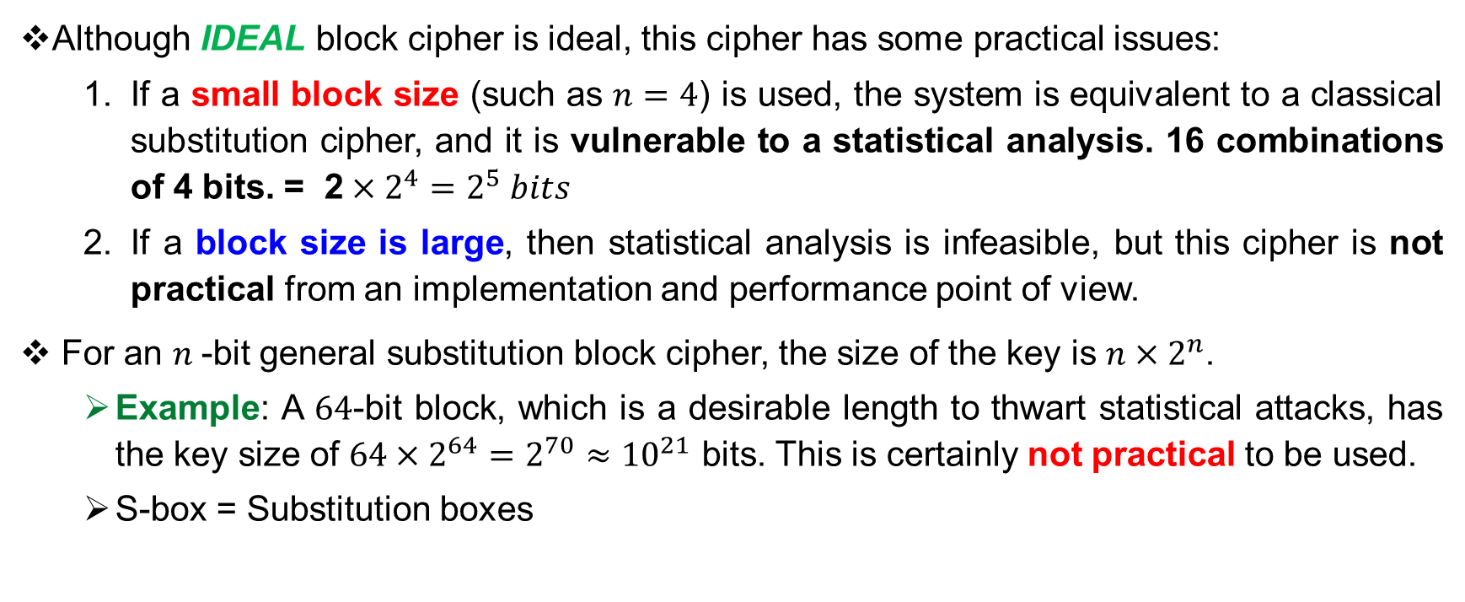
3rd Motivation – Practical Cipher
Although IDEAL block cipher is ideal, this cipher has some practical issues:
If a small block size (such as $n=4$) is used, the system is equivalent to a classical substitution cipher, and it is vulnerable to a statistical analysis. 16 combinations of 4 bits. = 2$×2^{4}=2^{5} bits$
If a block size is large, then statistical analysis is infeasible, but this cipher is not practical from an implementation and performance point of view.
For an $n$-bit general substitution block cipher, the size of the key is $n×2^{n}$.
Example: A $64$-bit block, which is a desirable length to thwart statistical attacks, has the key size of $64×2^{64}=2^{70}≈{10}^{21}$ bits. This is certainly not practical to be used.
S-box = Substitution boxes

Slide 16
FEISTEL CIPHER STRUCTURES

Slide 17
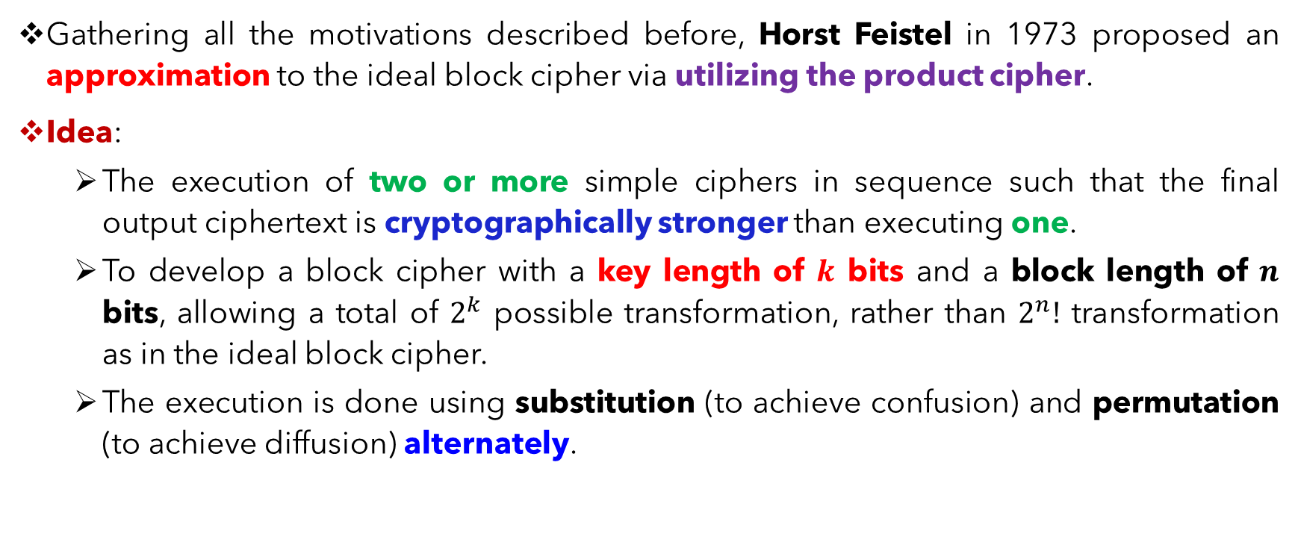
Feistel Cipher Structure – Optimal Solution
Gathering all the motivations described before, Horst Feistel in 1973 proposed an approximation to the ideal block cipher via utilizing the product cipher.
Idea:
The execution of two or more simple ciphers in sequence such that the final output ciphertext is cryptographically stronger than executing one.
To develop a block cipher with a key length of $k$ bits and a block length of $n$ bits, allowing a total of $2^{k}$ possible transformation, rather than $2^{n}!$ transformation as in the ideal block cipher.
The execution is done using substitution (to achieve confusion) and permutation (to achieve diffusion) alternately.

Slide 18
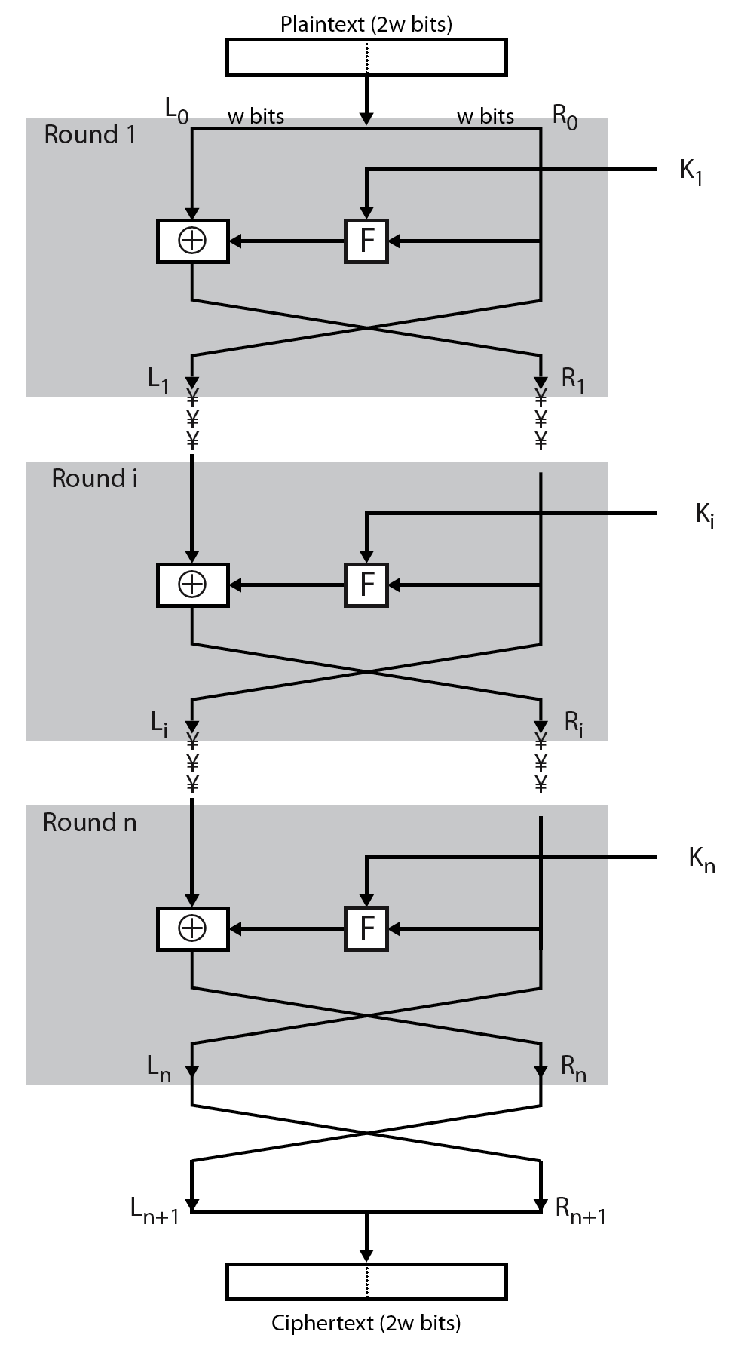
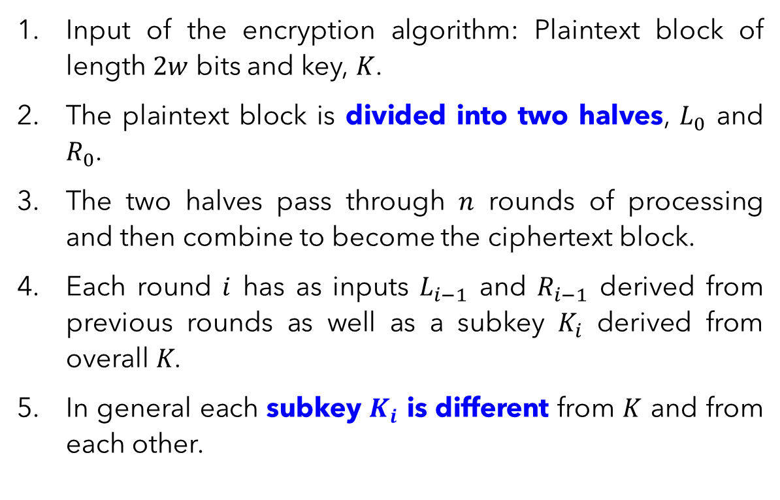
Feistel Cipher Structure
Input of the encryption algorithm: Plaintext block of length $2w$ bits and key, $K$.
The plaintext block is divided into two halves, $L_{0}$ and $R_{0}$.
The two halves pass through $n$ rounds of processing and then combine to become the ciphertext block.
Each round $i$ has as inputs $L_{i−1}$ and $R_{i−1}$ derived from previous rounds as well as a subkey $K_{i}$ derived from overall $K$.
In general each subkey $K_{i}$ is different from $K$ and from each other.

Slide 19
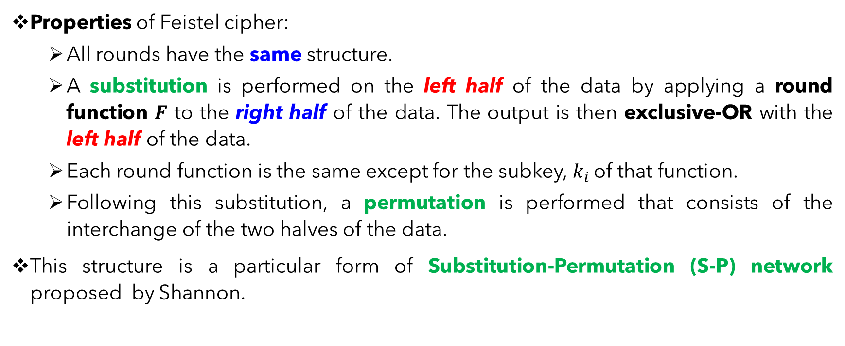
Feistel Cipher Structure
Properties of Feistel cipher:
All rounds have the same structure.
A substitution is performed on the left half of the data by applying a round function $F$ to the right half of the data. The output is then exclusive-OR with the left half of the data.
Each round function is the same except for the subkey, $k_{i}$ of that function.
Following this substitution, a permutation is performed that consists of the interchange of the two halves of the data.
This structure is a particular form of Substitution-Permutation (S-P) network proposed by Shannon.

Slide 20
Feistel Cipher – Parameters & Design
Block size:
Larger block size assures greater security, but reduce computational efficiency (speed).
Block size of 64 bits is traditionally nearly universal in block cipher design. But the new AES uses a 128-bit block size.
Key size:
Larger key size assures greater security to resist brute-force attack, but reduce computational efficiency (speed).
An adequate and common key size in deployment is 128 bits.
Number of rounds:
Multiple rounds performed to increase security strength.
A typical number of rounds is 16.

Slide 21
Feistel Cipher – Parameters & Design
Subkey generation algorithm:
Greater complexity in this algorithm should lead to greater difficulty of cryptanalysis.
Round function:
Greater complexity generally means greater resistance to cryptanalysis
Fast software encryption/decryption:
Since encryption is embedded in applications or utility functions, the speed of execution of the algorithm becomes a concern.
Ease of analysis:
Algorithm should be easy to analyse for cryptanalytic vulnerabilities and develop a higher level of assurance as to its strength.

Slide 22
DATA ENCRYPTION STANDARD (DES)

Slide 23
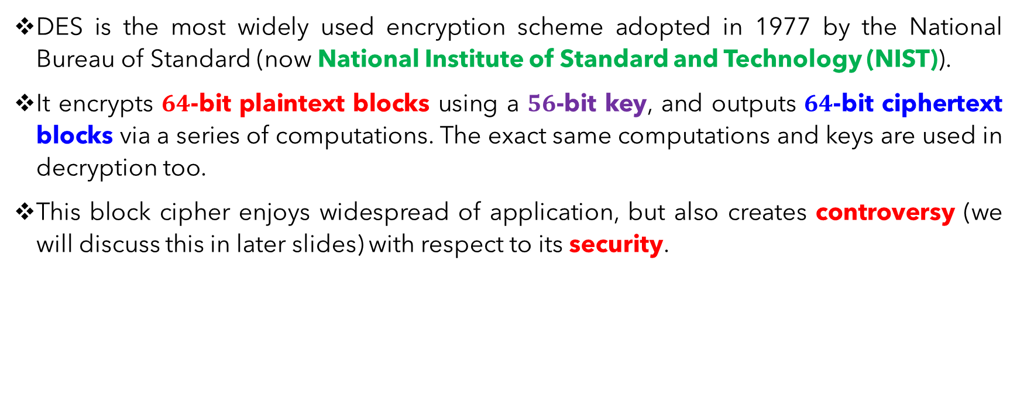
Data Encryption Standard (DES) - Introduction
DES is the most widely used encryption scheme adopted in 1977 by the National Bureau of Standard (now National Institute of Standard and Technology (NIST)).
It encrypts $64$-bit plaintext blocks using a $56$-bit key, and outputs $64$-bit ciphertext blocks via a series of computations. The exact same computations and keys are used in decryption too.
This block cipher enjoys widespread of application, but also creates controversy (we will discuss this in later slides) with respect to its security.

Slide 24
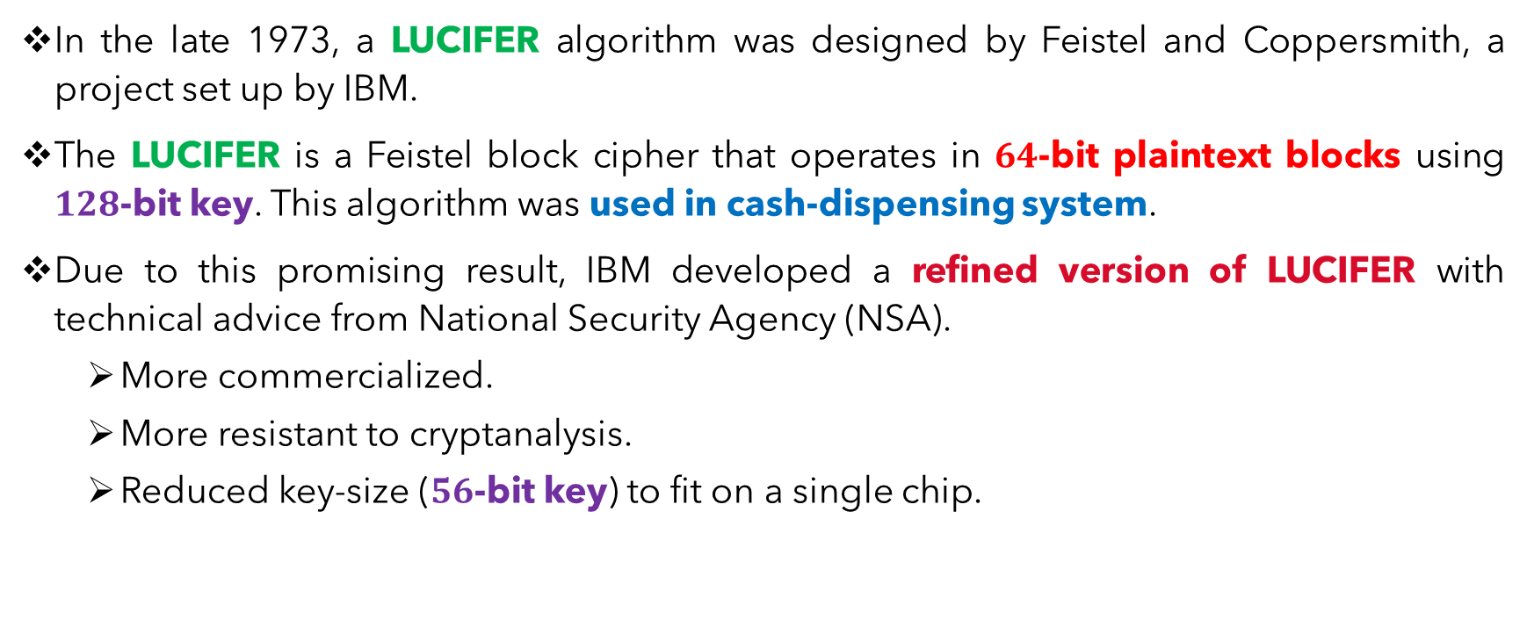
Data Encryption Standard (DES) - History
In the late 1973, a LUCIFER algorithm was designed by Feistel and Coppersmith, a project set up by IBM.
The LUCIFER is a Feistel block cipher that operates in $64$-bit plaintext blocks using $128$-bit key. This algorithm was used in cash-dispensing system.
Due to this promising result, IBM developed a refined version of LUCIFER with technical advice from National Security Agency (NSA).
More commercialized.
More resistant to cryptanalysis.
Reduced key-size ($56$-bit key) to fit on a single chip.

Slide 25
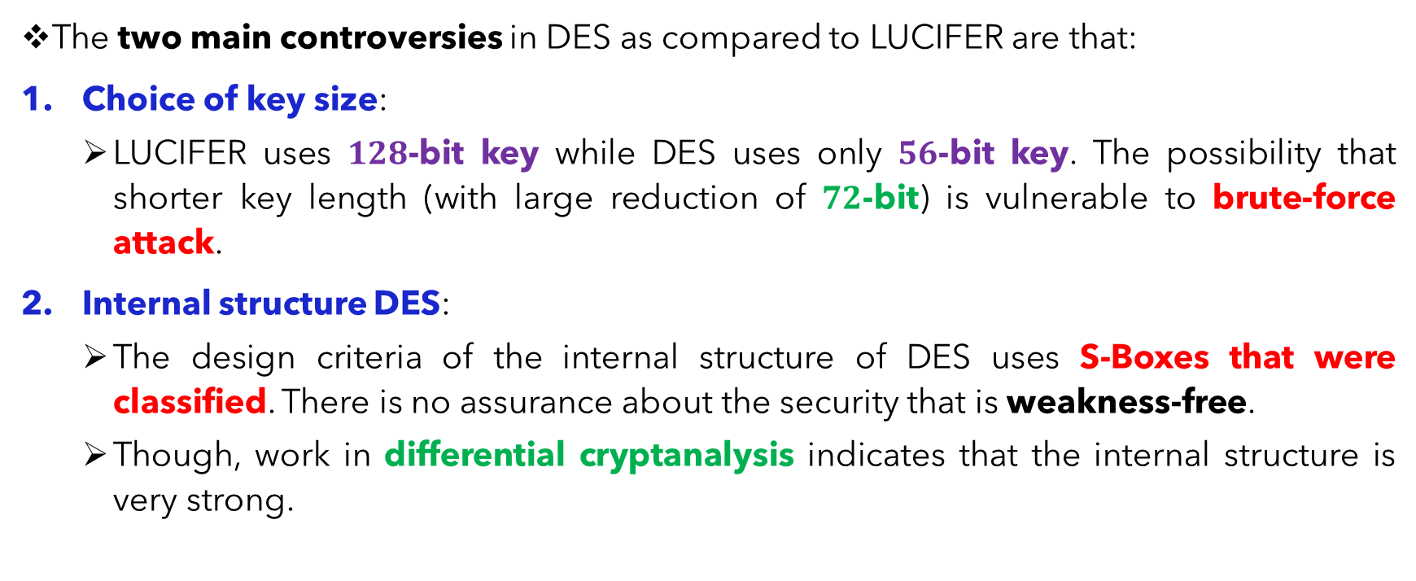
Data Encryption Standard (DES) - Controversy
The two main controversies in DES as compared to LUCIFER are that:
Choice of key size:
LUCIFER uses $128$-bit key while DES uses only $56$-bit key. The possibility that shorter key length (with large reduction of $72$-bit) is vulnerable to brute-force attack.
Internal structure DES:
The design criteria of the internal structure of DES uses S-Boxes that were classified. There is no assurance about the security that is weakness-free.
Though, work in differential cryptanalysis indicates that the internal structure is very strong.

Slide 26
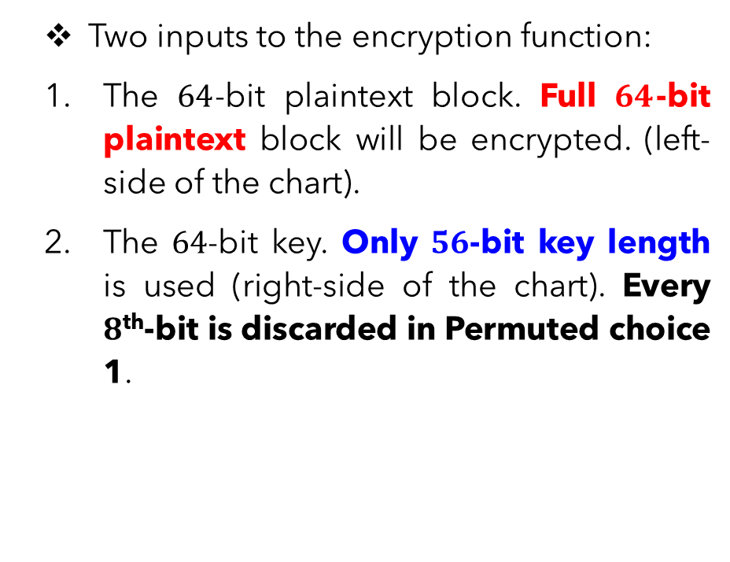
DES – Encryption Algorithm (Overview)
Two inputs to the encryption function:
The $64$-bit plaintext block. Full $64$-bit plaintext block will be encrypted. (left-side of the chart).
The $64$-bit key. Only $56$-bit key length is used (right-side of the chart). Every $8$^{th}-bit is discarded in Permuted choice 1.

Slide 27
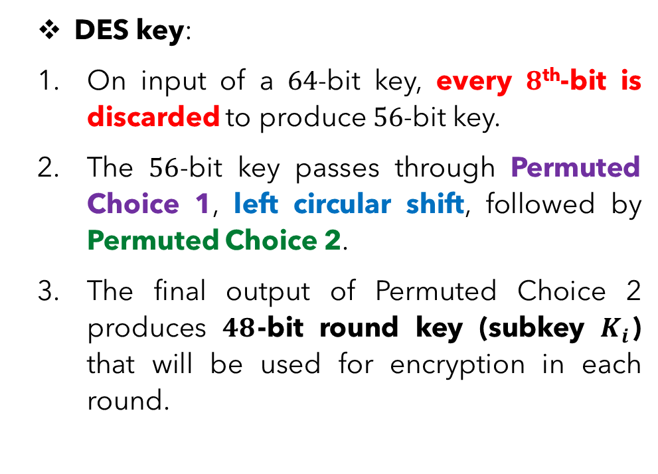
DES – Encryption Algorithm (Key)
Bit 8,16, 24…
DES key:
On input of a $64$-bit key, every $8$^{th}-bit is discarded to produce $56$-bit key.
The $56$-bit key passes through Permuted Choice 1, left circular shift, followed by Permuted Choice 2.
The final output of Permuted Choice 2 produces $48$-bit round key (subkey $K_{i}$) that will be used for encryption in each round.

Slide 28
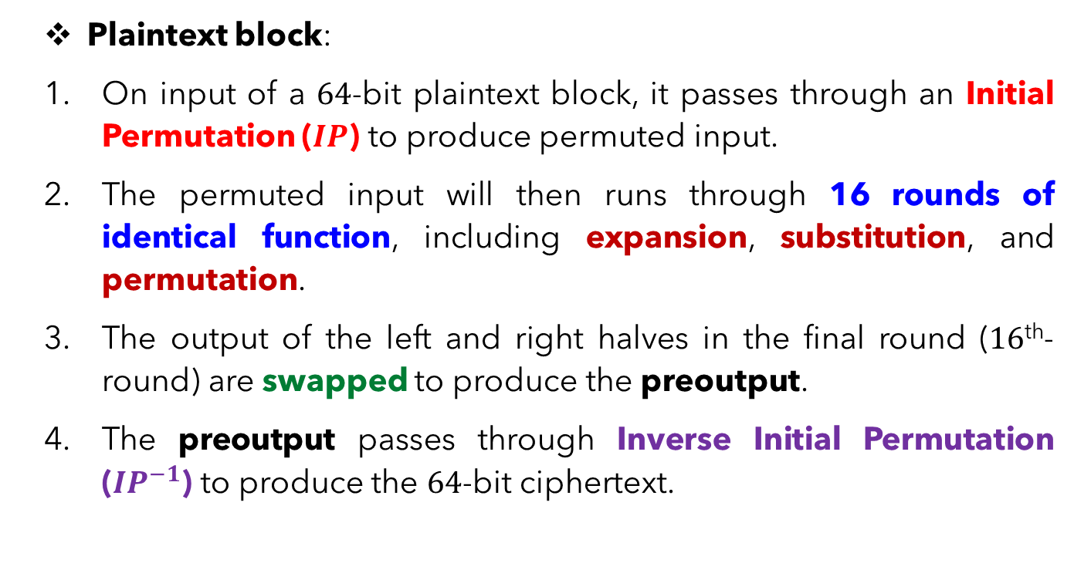
DES – Encryption Algorithm (Plaintext Block)
Plaintext block:
On input of a $64$-bit plaintext block, it passes through an Initial Permutation ($IP$) to produce permuted input.
The permuted input will then runs through 16 rounds of identical function, including expansion, substitution, and permutation.
The output of the left and right halves in the final round ($16$^{th}-round) are swapped to produce the preoutput.
The preoutput passes through Inverse Initial Permutation (${IP}^{−1}$) to produce the $64$-bit ciphertext.

Slide 29
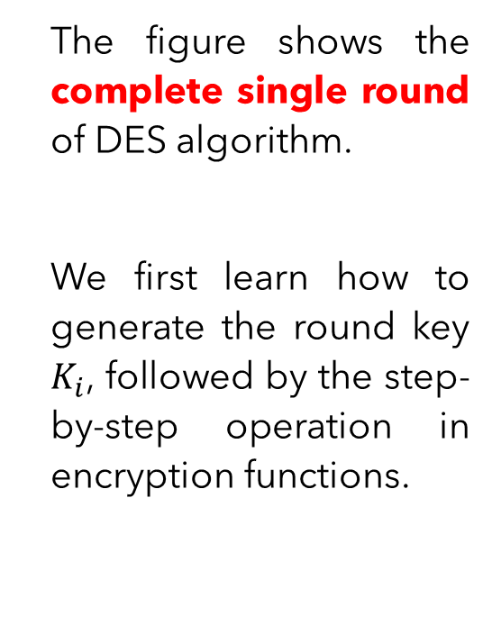
DES – Single Round
The figure shows the complete single round of DES algorithm.
We first learn how to generate the round key $K_{i}$, followed by the step-by-step operation in encryption functions.

Slide 30
DATA ENCRYPTION STANDARD (DES) ROUND (SUBKEY) GENERATION

Slide 31


DES – Key Generation (Input Key)
On input of a $64$-bit key, every $8$^{th}-bit is discarded to produce $56$-bit key.
After arranging the key bits, discard the bit in every $8$^{th} position.

Slide 32


DES – Key Generation (Permuted Choice 1)
The $56$-bit key passes through Permuted Choice 1 (PC1) according to the arrangement in the following table. Note that all the $8$^{th}-bit $\left(8,16,24,32,40,48,56,64\right)$ are already discarded here.
LEFT
The output of the PC1 is immediately parted into TWO halves (left and right with $28$ bits each)
RIGHT

Slide 33
Permuted Choice 1
right
1 | 2 | 3 | 4 | 5 | 6 | 7 | 8 |  |  | 26 | 27 | 28 | 29 | 30 | 31 | .. |  |  |  |  | 48 | 49 | 50 | 51 | 52 | 53 | 54 | 55 | 56
57 | 49 | 41 | 33 | 25 | 17 | 9 | 1 | .. | .. |  | 44 | 36 | 63 | 55 | 47 |  |  |  |  |  | 37 | 29 | 21 | 13 | 5 | 28 | 20 | 12 | 4
Bit location from the 64 bit key

Slide 34
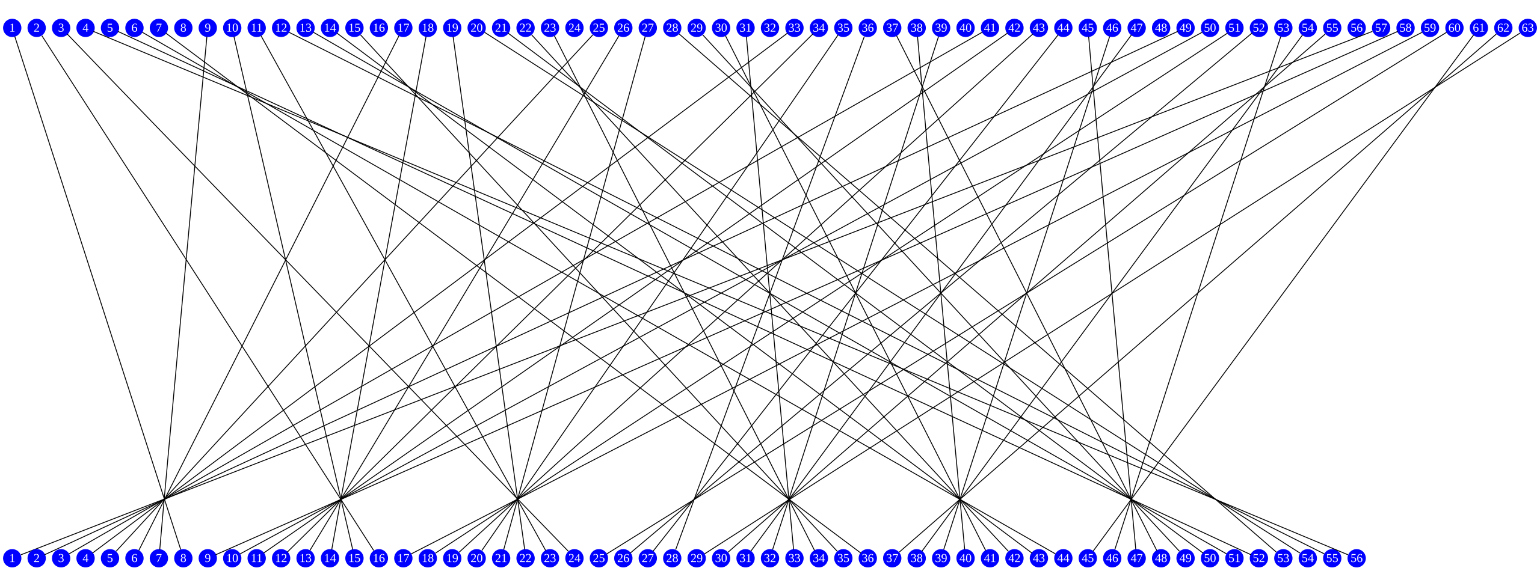
Permutation Choice 1

Slide 35
DES – Key Generation (Left Circular Shift)
Each half of left and right block undergoes left shifts according the current of subkey generation.
For Round 1, 2, 9, and 16 subkeys generation, ONE bit is shifted to the left.
For the other rounds of subkey generation, TWO bits are shifted to the left.
4 x 1 shift , 12 round x 2 = 24 + 4 = 28 bits x 2 = 56 bits

Slide 36
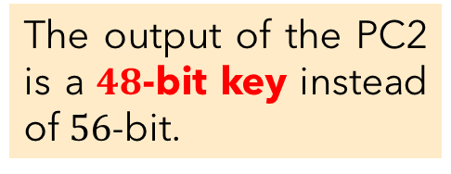

DES – Key Generation (Permuted Choice 2)
After the left circular shift, both left and right halves pass through the Permuted Choice 2 (PC2) for further compression into $48$-bit keys. This is the Round key $K_{i}$ that will be used for single round Feistel encryption.
The output of the PC2 is a $48$-bit key instead of $56$-bit.
Ignore bit : 9, 18, 22, 25, 35, 38, 43, 54.

Slide 37
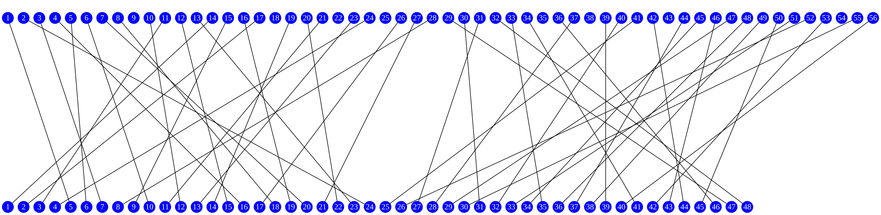
Permuted Choice-2

Slide 38
DES – Key Generation
While passing the left and right halves to Permuted Choice 2, these left-shifted key blocks are also repeating the identical operations in Step 3 to generator subkey in NEXT round.

Slide 39
DATA ENCRYPTION STANDARD (DES) ENCRYPTION ALGORITHM
Initial Permutation

Slide 40

DES – Encryption Algorithm (Initial Permutation)
On input of a $64$-bit plaintext block, it is permuted using the Initial Permutation ($IP$) table as follows.
The permuted plaintext block is then split into two halves of $32$-bit left block $L_{i}$ and $32$-bit right block $R_{i}$.

Slide 41
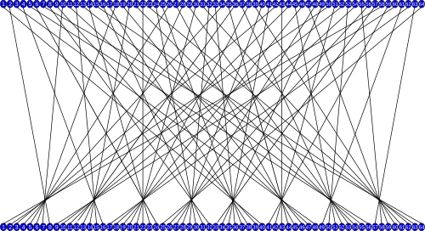
IP

Slide 42
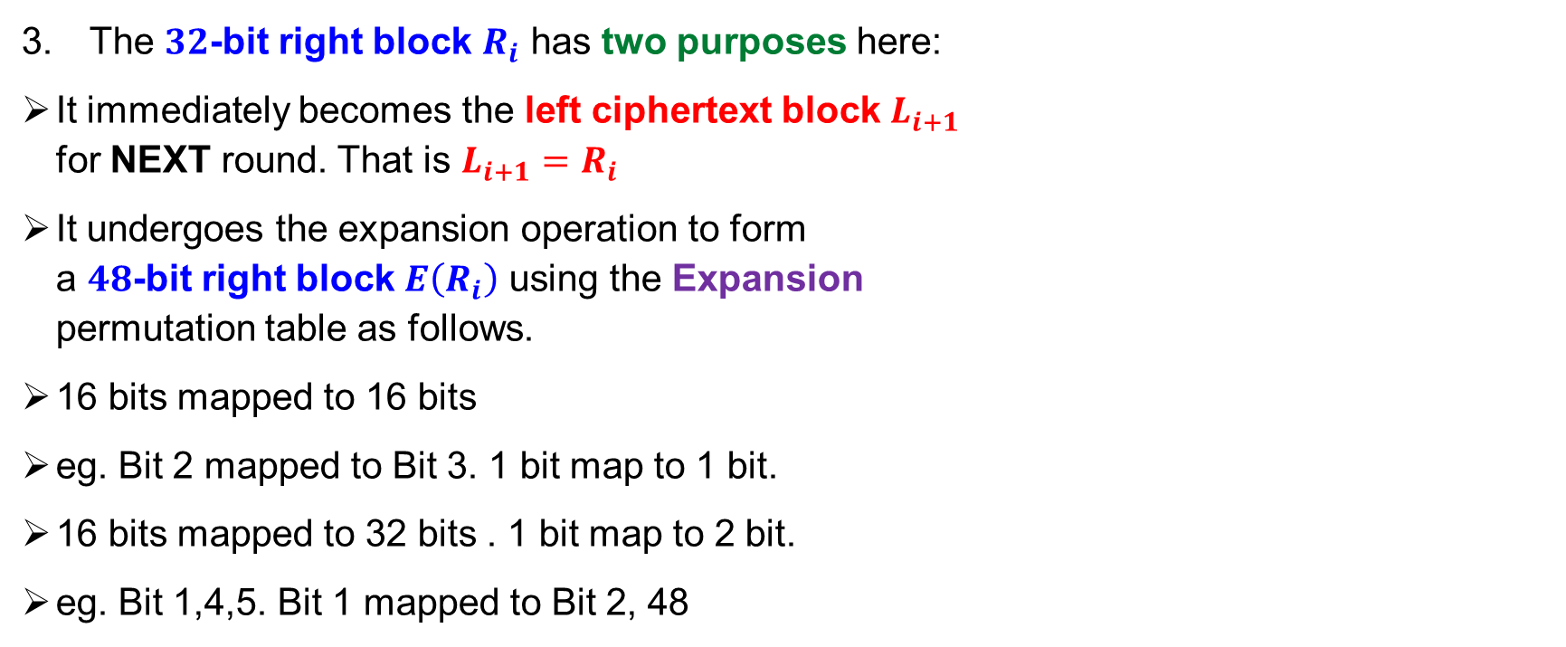
DES – Encryption Algorithm (Expansion)
The $32$-bit right block $R_{i}$ has two purposes here:
It immediately becomes the left ciphertext block $L_{i+1}$ for NEXT round. That is $L_{i+1}=R_{i}$
It undergoes the expansion operation to form a $48$-bit right block $E\left(R_{i}\right)$ using the Expansion permutation table as follows.
16 bits mapped to 16 bits
eg. Bit 2 mapped to Bit 3. 1 bit map to 1 bit.
16 bits mapped to 32 bits . 1 bit map to 2 bit.
eg. Bit 1,4,5. Bit 1 mapped to Bit 2, 48

Slide 43
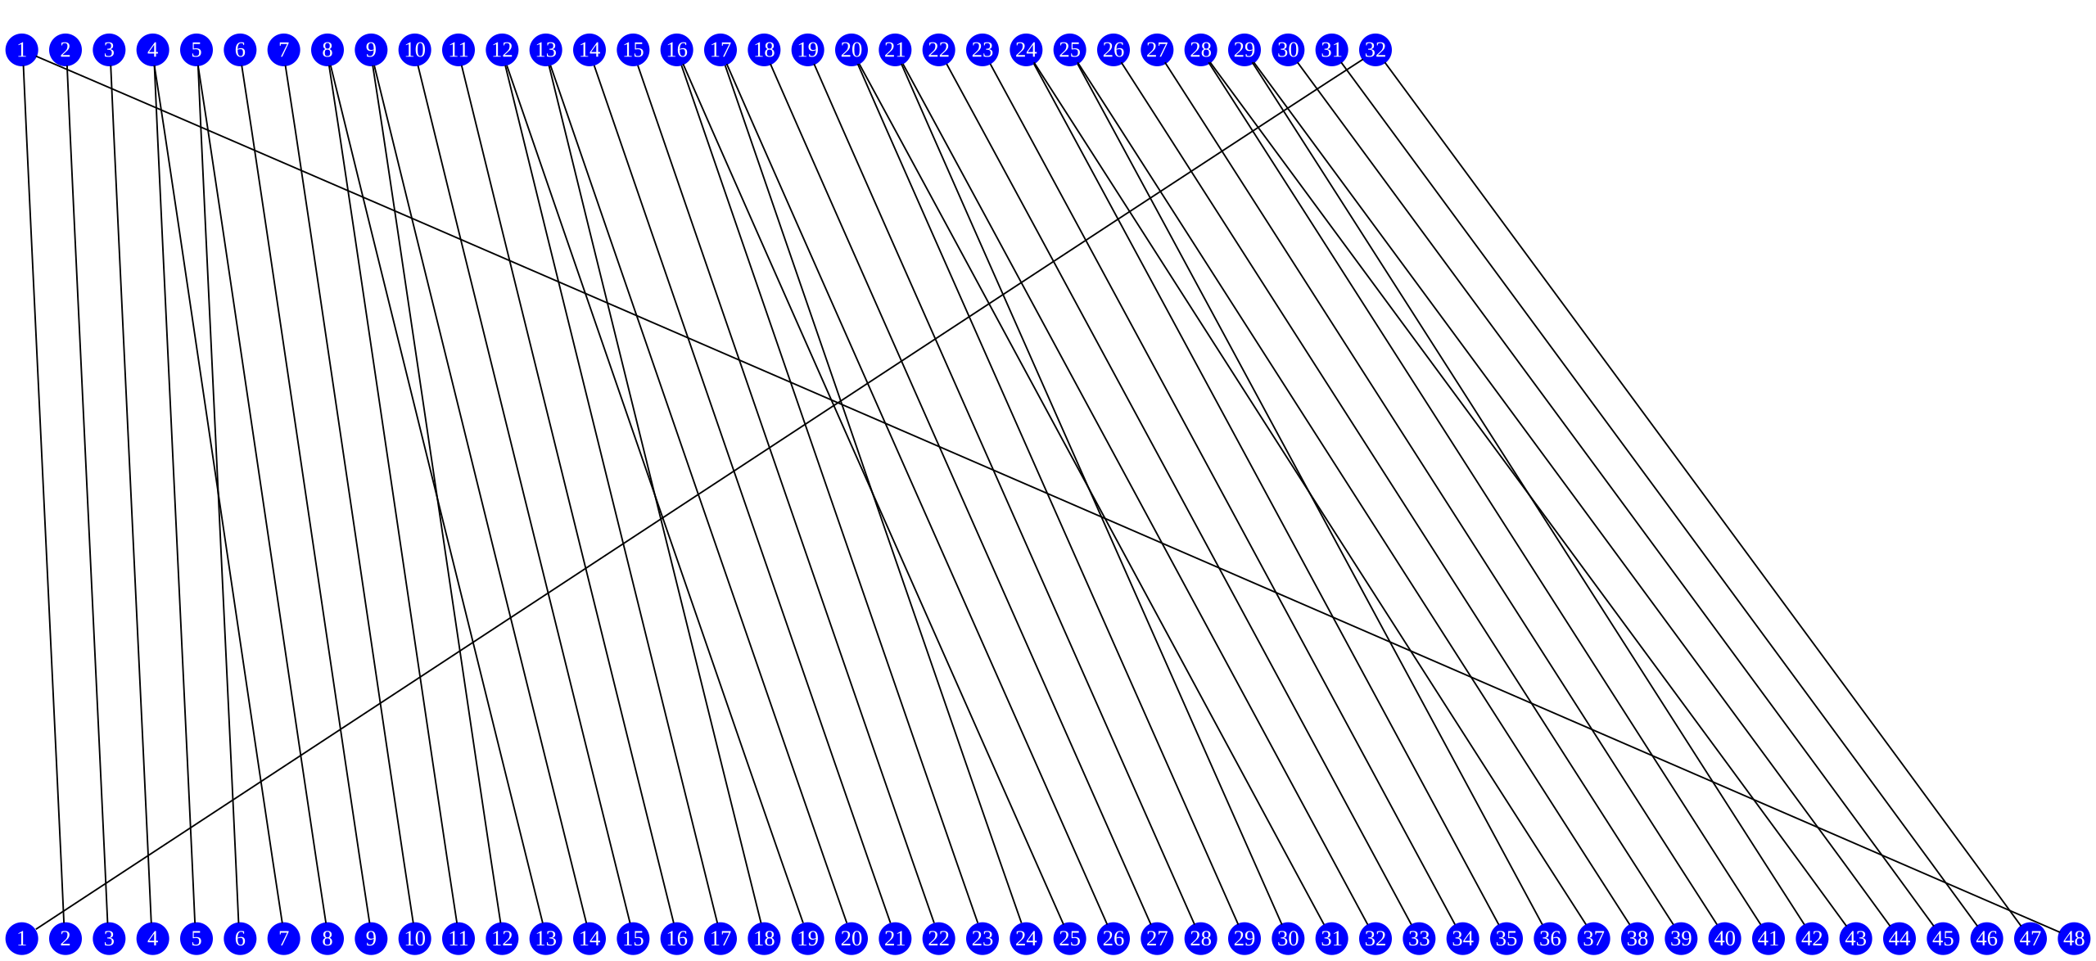
DES Expansion

Slide 44
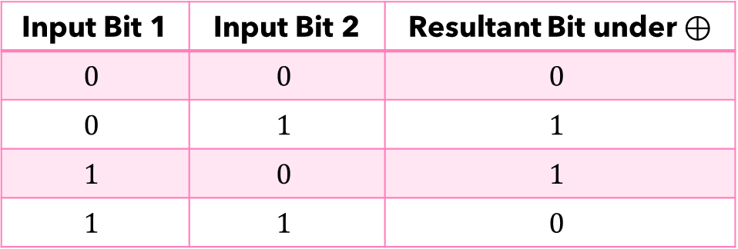

DES – Encryption Algorithm (Exclusive-OR)
The expanded $48$-bit right block $E\left(R_{i}\right)$ is then XOR (exclusive-OR) with the subkey $K_{i}$ generated previously to produce a $48$-bit block. Mathmatically, $E\left(R_{i}\right)⊕K_{i}$. Recall that exclusive-OR operations:
Input Bit 1 | Input Bit 2 | Resultant Bit under $⊕$
$$0$$ | $$0$$ | $$0$$
$$0$$ | $$1$$ | $$1$$
$$1$$ | $$0$$ | $$1$$
$$1$$ | $$1$$ | $$0$$

Slide 45
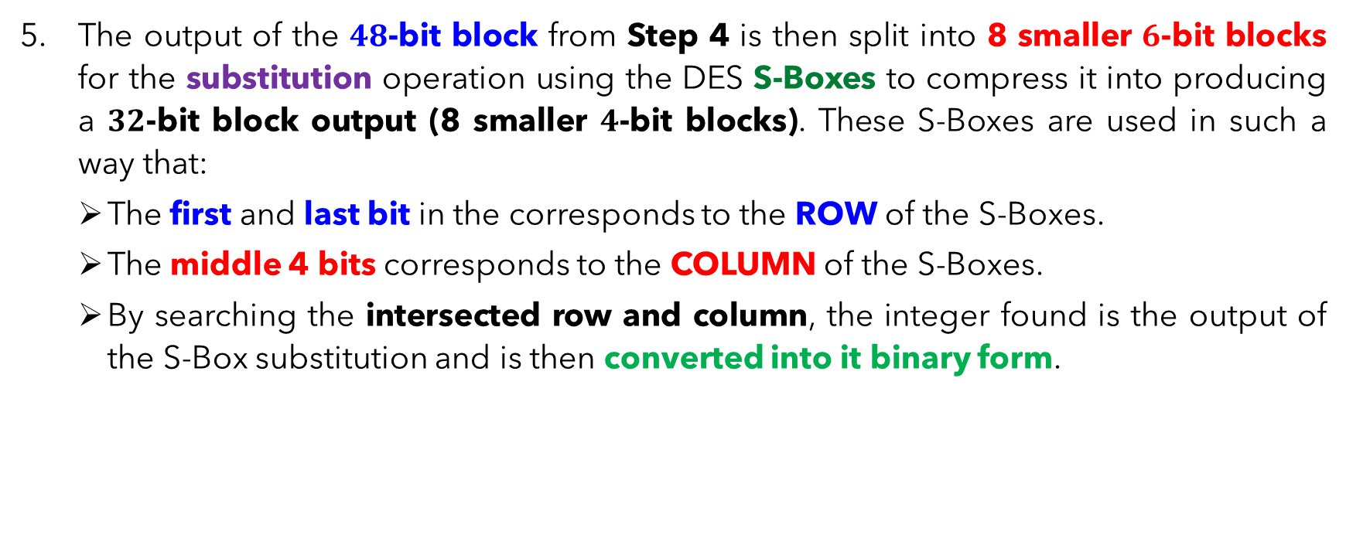
DES – Encryption Algorithm (Substitution)
The output of the $48$-bit block from Step 4 is then split into 8 smaller $6$-bit blocks for the substitution operation using the DES S-Boxes to compress it into producing a $32$-bit block output (8 smaller $4$-bit blocks). These S-Boxes are used in such a way that:
The first and last bit in the corresponds to the ROW of the S-Boxes.
The middle 4 bits corresponds to the COLUMN of the S-Boxes.
By searching the intersected row and column, the integer found is the output of the S-Box substitution and is then converted into it binary form.

Slide 46
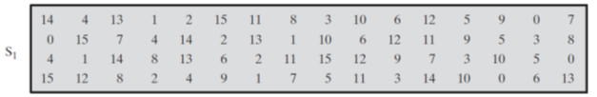
S-Box
Input = 48 bits. 8 x 6 = 48
8 S-Box. Each of them translate 6 bit =>. 4 bit.
Output = 32 bits. 4 x 8 = 32
Position | 1 | 2 | 3 | 4 | 5 | 6
Value | 1 | 0 | 1 | 1 | 1 | 0
Row : 10 = 2 (Position 1 and 6)
Column : 0111 = 7 (position 2 to 5)
What is the value of [2,7] in S1 table ?
11 => 1011
101110 =➔ 1011

Slide 47
S-Box: Exercise
Input = 48 bits. 8 x 6 = 48
8 S-Box. Each of them translate 6 bit =>. 4 bit.
Output = 32 bits. 4 x 8 = 32
Position | 1 | 2 | 3 | 4 | 5 | 6
Value | 1 | 0 | 1 | 1 | 1 | 0
Row : 10 = 2 (Position 1 and 6) red
Column : 0111 = 7 (position 2 to 5)
What is the value of [2,7] in S1 table ?
11 => 1011
Thus,
101110 =➔ 1011
Question:
If input = 011011
What is the output for S1?
row1, column 13
5
011011 => 0101

Slide 48
DES – Encryption Algorithm (Substitution)

Slide 49
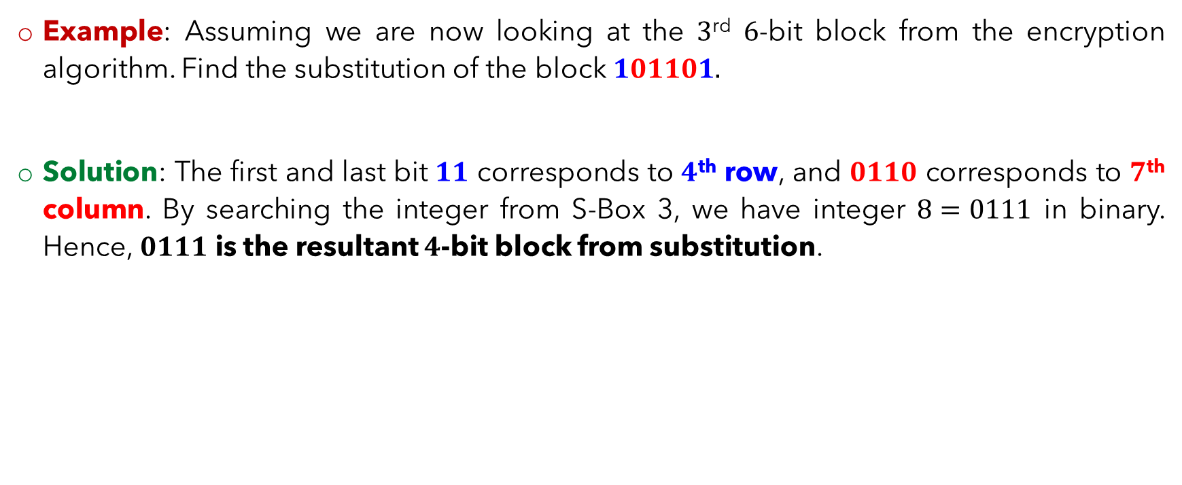
DES – Encryption Algorithm (Substitution)
Example: Assuming we are now looking at the $3$^{rd} $6$-bit block from the encryption algorithm. Find the substitution of the block $101101.$
Solution: The first and last bit $11$ corresponds to $4$^{th} row, and $0110$ corresponds to $7$^{th} column. By searching the integer from S-Box 3, we have integer $8=0111$ in binary. Hence, $0111$ is the resultant $4$-bit block from substitution.

Slide 50

DES – Encryption Algorithm (Permutation)
The output compressed $32$-bit block is next undergoes the permutation using the P-table as follows.

Slide 51
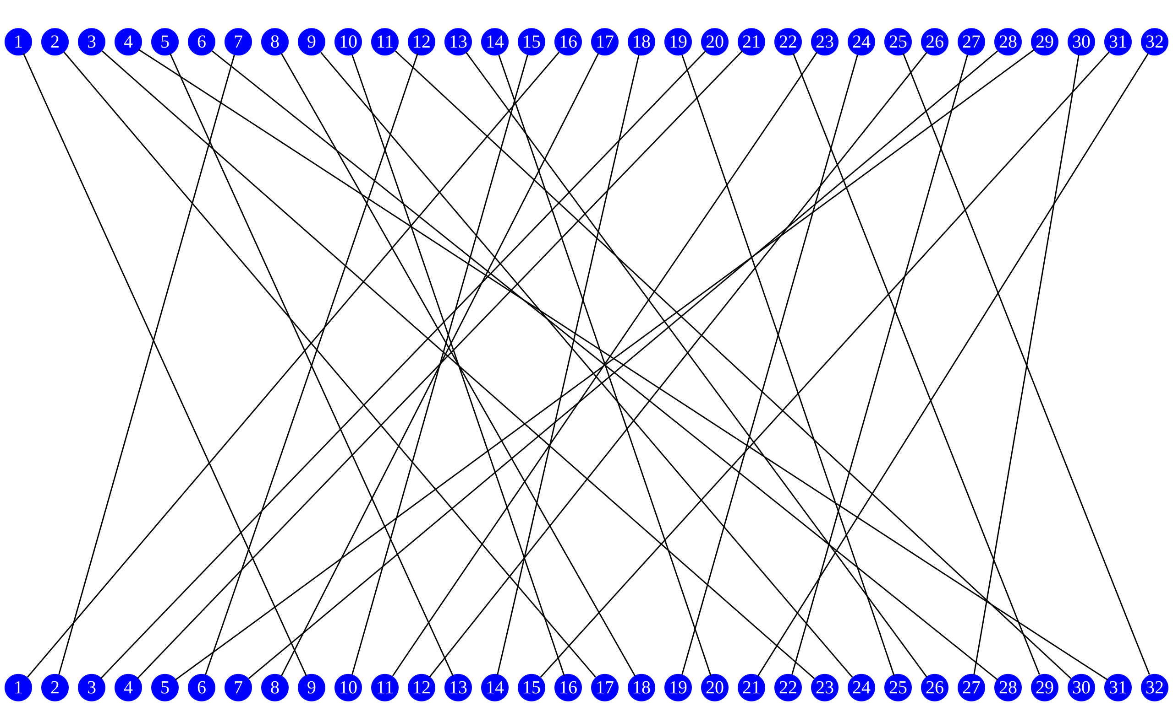
Permutation

Slide 52
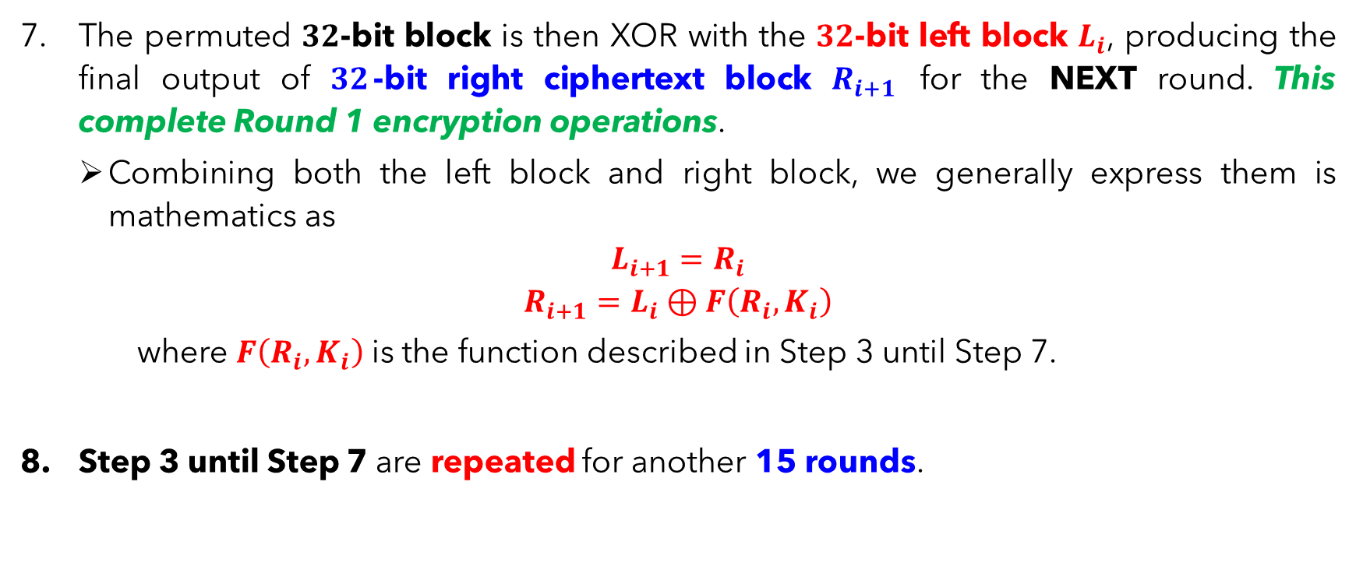
DES – Encryption Algorithm (Exclusive-OR)
The permuted $32$-bit block is then XOR with the $32$-bit left block $L_{i}$, producing the final output of $32$-bit right ciphertext block $R_{i+1}$ for the NEXT round. This complete Round 1 encryption operations.
Combining both the left block and right block, we generally express them is mathematics as
$$L_{i+1}=R_{i}$$
$$R_{i+1}=L_{i}⊕F\left(R_{i},K_{i}\right)$$
where $F\left(R_{i},K_{i}\right)$ is the function described in Step 3 until Step 7.
Step 3 until Step 7 are repeated for another 15 rounds.

Slide 53

DES – Encryption Algorithm (Inverse Initial Permutation)
At the end of Round 16, the left and right ciphertext blocks $L_{16}$ and $R_{16}$ are swapped and will undergo the last inverse initial permutation (${IP}^{−1}$) using the following table to produce the final output DES ciphertext block.

Slide 54
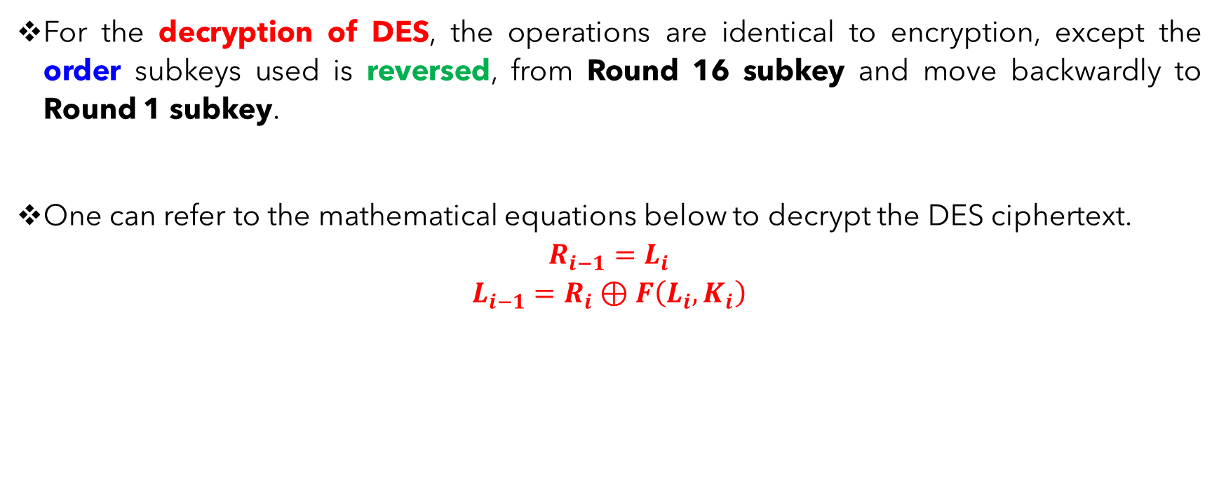
DES – Decryption Algorithm
For the decryption of DES, the operations are identical to encryption, except the order subkeys used is reversed, from Round 16 subkey and move backwardly to Round 1 subkey.
One can refer to the mathematical equations below to decrypt the DES ciphertext.
$$R_{i−1}=L_{i}$$
$$L_{i−1}=R_{i}⊕F\left(L_{i},K_{i}\right)$$

Slide 55
DES – The Avalanche Effect
A factor that makes DES a preferred symmetric encryption is its strong Avalanche effect, a property that is desirably by any encryption algorithm.
Avalanche effect:
A change of one bit of plaintext input or key bit should result in
changing approximately half of the output ciphertext bits.
It is very difficult to demonstrate an example here. Please refer to the Stallings textbook, page 86–87 for an example using 128-bit plaintext block.

Slide 56
DATA ENCRYPTION STANDARD (DES) VARIANTS

Slide 57
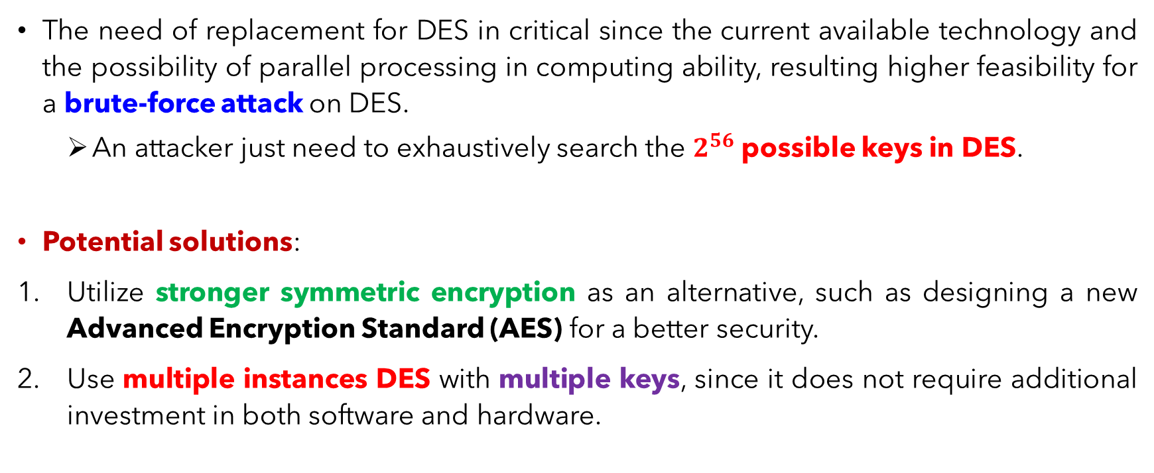
Multiple DES - Motivation
The need of replacement for DES in critical since the current available technology and the possibility of parallel processing in computing ability, resulting higher feasibility for a brute-force attack on DES.
An attacker just need to exhaustively search the $2^{56}$ possible keys in DES.
Potential solutions:
Utilize stronger symmetric encryption as an alternative, such as designing a new Advanced Encryption Standard (AES) for a better security.
Use multiple instances DES with multiple keys, since it does not require additional investment in both software and hardware.

Slide 58
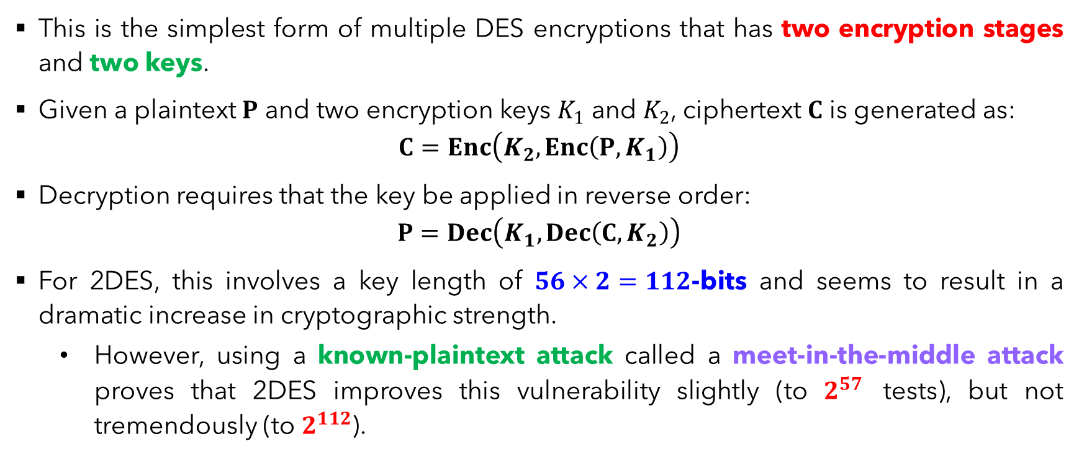
DES Variant – Double DES (2DES)
This is the simplest form of multiple DES encryptions that has two encryption stages and two keys.
Given a plaintext $P$ and two encryption keys $K_{1}$ and $K_{2}$, ciphertext $C$ is generated as:
$$C=Enc\left(K_{2},Enc\left(P,K_{1}\right)\right)$$
Decryption requires that the key be applied in reverse order:
$$P=Dec\left(K_{1},Dec\left(C,K_{2}\right)\right)$$
For 2DES, this involves a key length of $56×2=112$-bits and seems to result in a dramatic increase in cryptographic strength.
However, using a known-plaintext attack called a meet-in-the-middle attack proves that 2DES improves this vulnerability slightly (to $2^{57}$ tests), but not tremendously (to $2^{112}$).

Slide 59
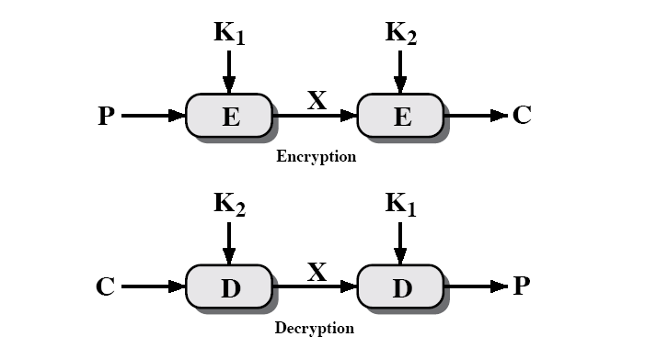


DES Variant – Double DES (2DES)
$C=Enc\left(K_{2},Enc\left(P,K_{1}\right)\right)$
$$P=Dec\left(K_{1},Dec\left(C,K_{2}\right)\right)$$

Slide 60
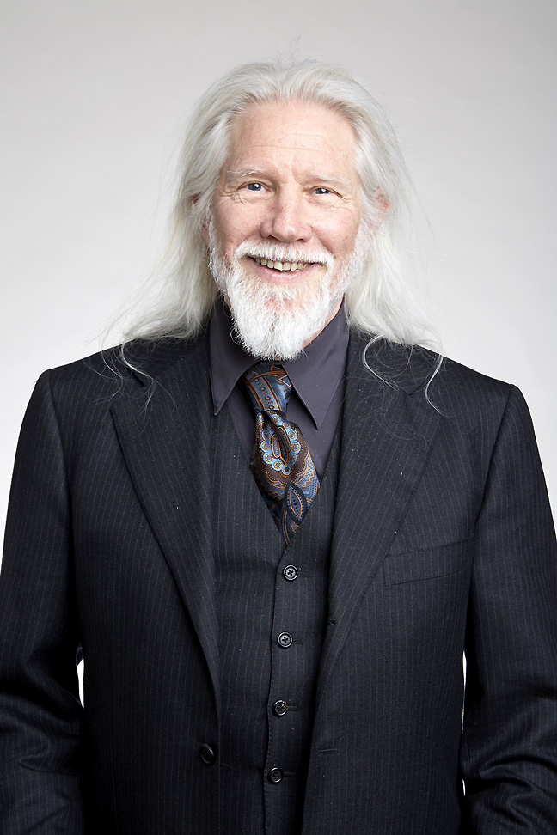
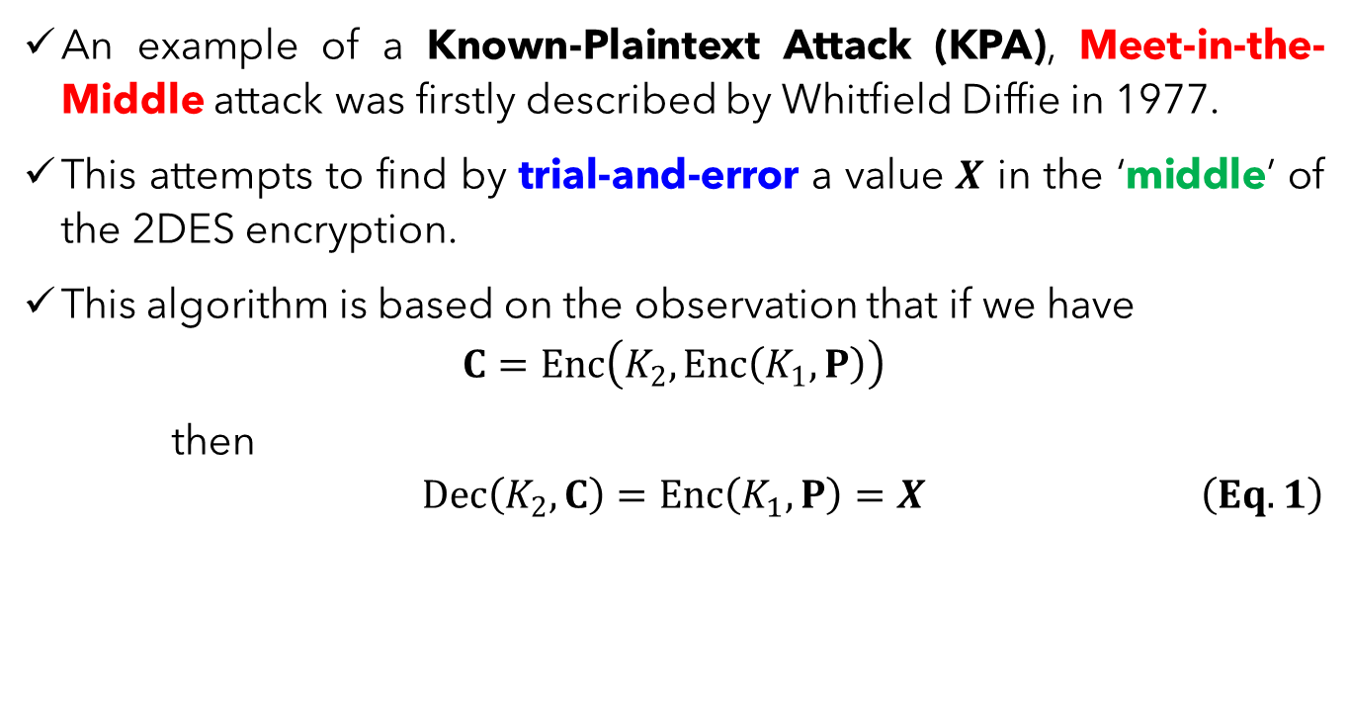
2DES – Meet-in-the-Middle Attack
An example of a Known-Plaintext Attack (KPA), Meet-in-the-Middle attack was firstly described by Whitfield Diffie in 1977.
This attempts to find by trial-and-error a value $X$ in the ‘middle’ of the 2DES encryption.
This algorithm is based on the observation that if we have
$$C=Enc\left(K_{2},Enc\left(K_{1},P\right)\right)$$
then
$$\begin{aligned} Dec\left(K_{2},C\right)=Enc\left(K_{1},P\right)=X \#\left(Eq. 1\right)\end{aligned}$$

Slide 61
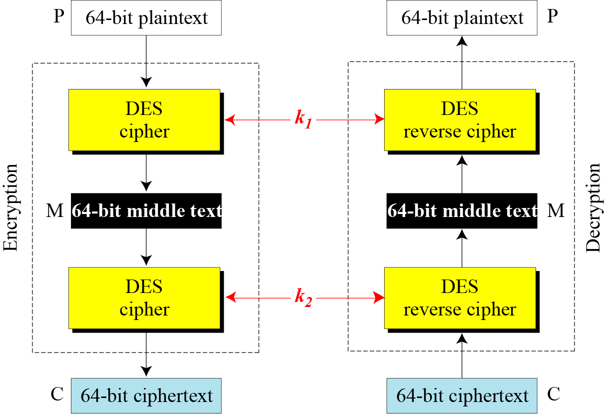
2DES – Meet-in-the-Middle Attack

Slide 62
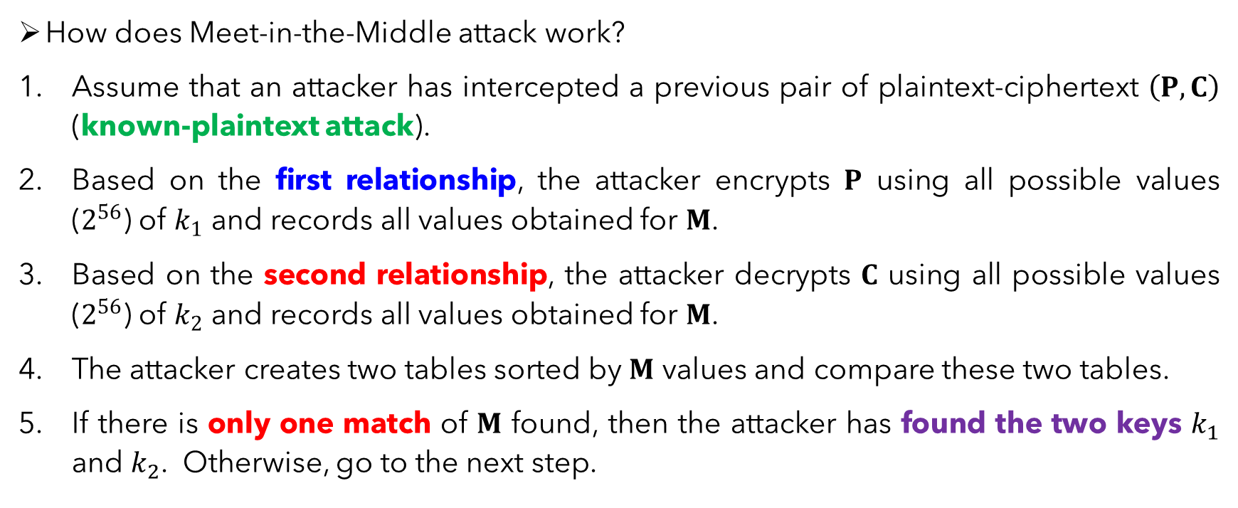
2DES – Meet-in-the-Middle Attack
How does Meet-in-the-Middle attack work?
Assume that an attacker has intercepted a previous pair of plaintext-ciphertext $\left(P,C\right)$ (known-plaintext attack).
Based on the first relationship, the attacker encrypts $P$ using all possible values ($2^{56}$) of $k_{1}$ and records all values obtained for $M$.
Based on the second relationship, the attacker decrypts $C$ using all possible values ($2^{56}$) of $k_{2}$ and records all values obtained for $M$.
The attacker creates two tables sorted by $M$ values and compare these two tables.
If there is only one match of $M$ found, then the attacker has found the two keys $k_{1}$ and $k_{2}$. Otherwise, go to the next step.

Slide 63
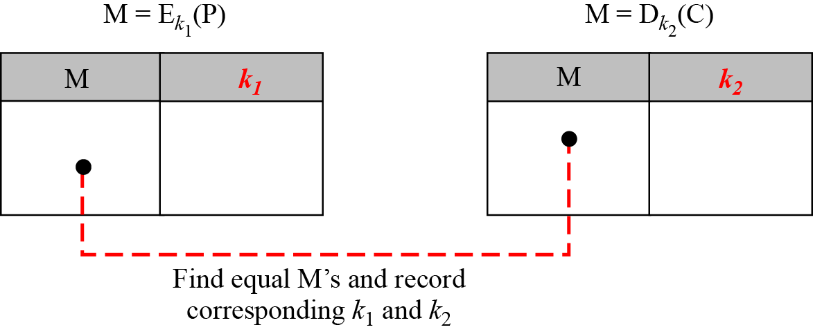

2DES – Meet-in-the-Middle Attack
The attacker takes another intercepted plaintext-ciphertext pair and uses each of the candidate key pairs to see if it is possible to get the ciphertext from the plaintext.
If more than one candidate key pair is found, the above Step 6 is repeated until a unique pair of $\left(k_{1},k_{2}\right)$ that produces the identical $M$is found.

Slide 64
DES Variant – Triple DES (3DES)
Another variant of DES proposed to improve its security, Triple DES (3DES) uses three stages of DES for encryption and decryption.
There are two version of 3DES in use today:
3DES with 2 keys.
3DES with 3 keys.

Slide 65
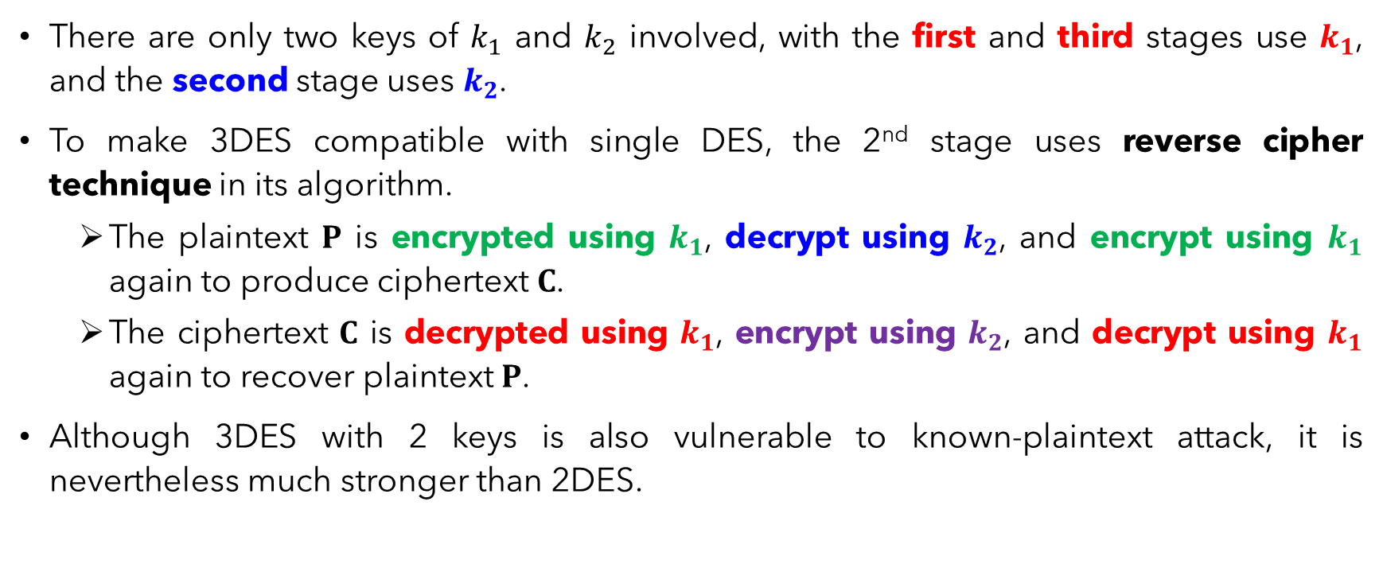
Triple DES (3DES) with 2 Keys
There are only two keys of $k_{1}$ and $k_{2}$ involved, with the first and third stages use $k_{1}$, and the second stage uses $k_{2}$.
To make 3DES compatible with single DES, the 2nd stage uses reverse cipher technique in its algorithm.
The plaintext $P$ is encrypted using $k_{1}$, decrypt using $k_{2}$, and encrypt using $k_{1}$ again to produce ciphertext $C$.
The ciphertext $C$ is decrypted using $k_{1}$, encrypt using $k_{2}$, and decrypt using $k_{1}$ again to recover plaintext $P$.
Although 3DES with 2 keys is also vulnerable to known-plaintext attack, it is nevertheless much stronger than 2DES.

Slide 66
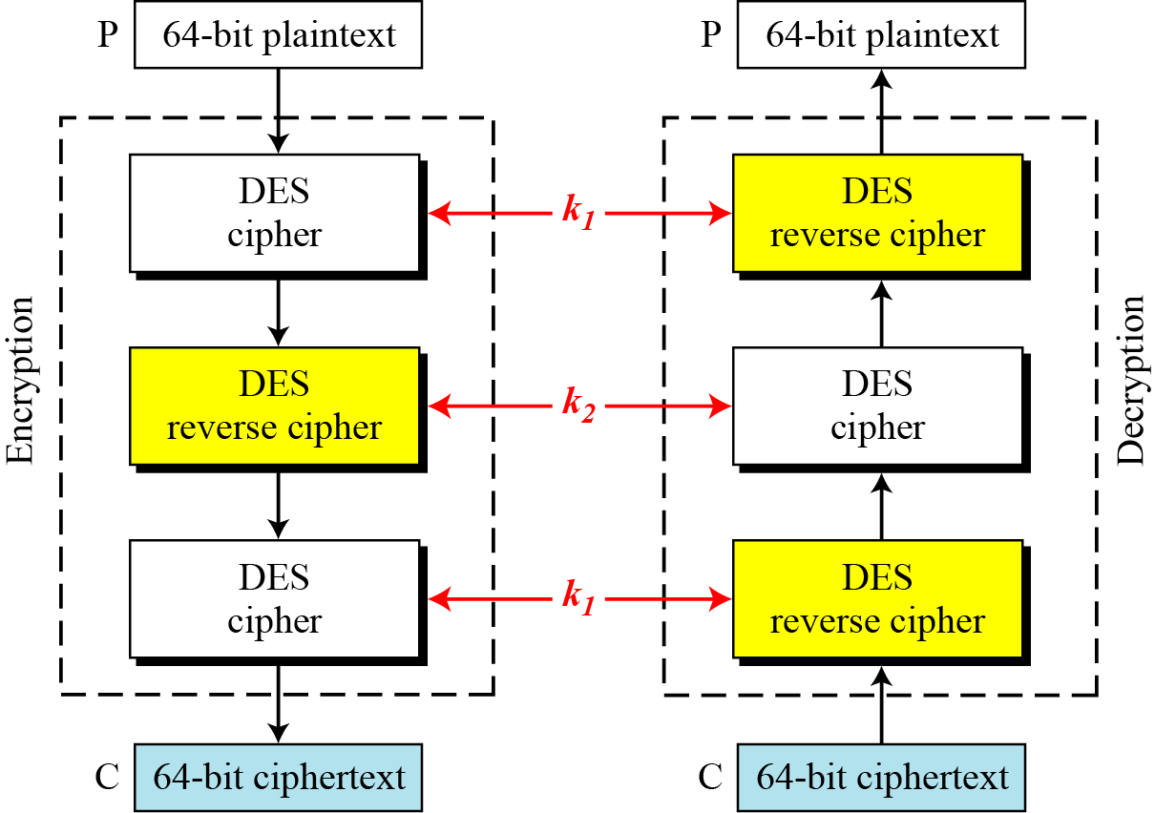
Triple DES (3DES) with 2 Keys

Slide 67
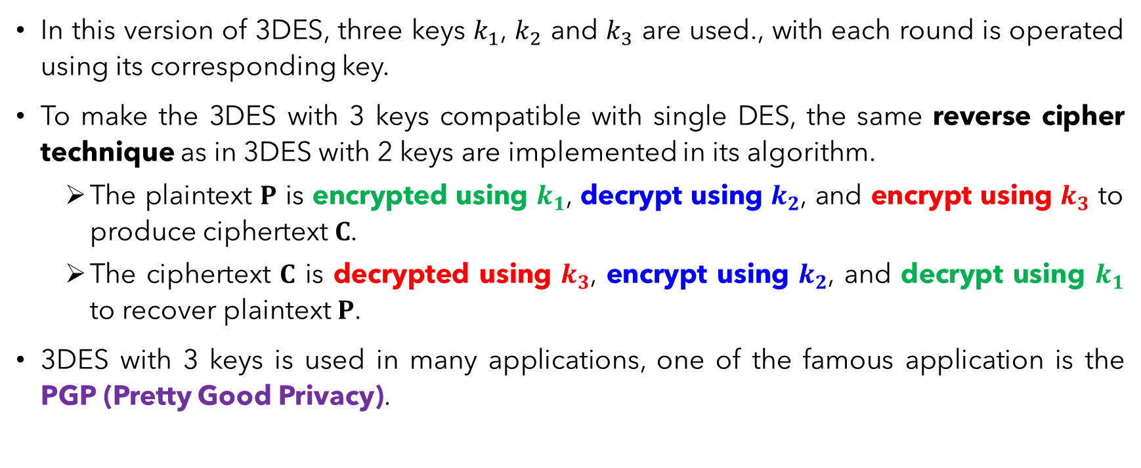
Triple DES (3DES) with 3 Keys
In this version of 3DES, three keys $k_{1}$, $k_{2}$ and $k_{3}$ are used., with each round is operated using its corresponding key.
To make the 3DES with 3 keys compatible with single DES, the same reverse cipher technique as in 3DES with 2 keys are implemented in its algorithm.
The plaintext $P$ is encrypted using $k_{1}$, decrypt using $k_{2}$, and encrypt using $k_{3}$ to produce ciphertext $C$.
The ciphertext $C$ is decrypted using $k_{3}$, encrypt using $k_{2}$, and decrypt using $k_{1}$ to recover plaintext $P$.
3DES with 3 keys is used in many applications, one of the famous application is the PGP (Pretty Good Privacy).

Slide 68
Main References for Chapter 4
Stallings, W. “Cryptography and Network Security: Principles and Practices”, Fifth Edition, Pearson Prentice Hall, 2011.
Forouzan, B.A. “Introduction to Cryptography and Network Security”, Third Edition, McGraw-Hill, 2008.

Slide 69
Summary
Key generation
Encryption Fiestel Function.
=> Expansion. 32 bit => 48 bits.

Slide 70
Grouping
Opt 1: Individual component 1st, Then join a group 2-3 person from other component.
Opt 2: Group straight away. Do 2-3 components

Slide 71
~ THE END ☺ ~

